Slide 1

Operating Systems
Designed by Mr. M Mudassar

Slide 2
Outline
Process
Threads
CPU Scheduling
Process Synchronization
Deadlocks
Memory Management
Virtual Memory
File System
I/O System
Disk Management
Protection
Security

Slide 3
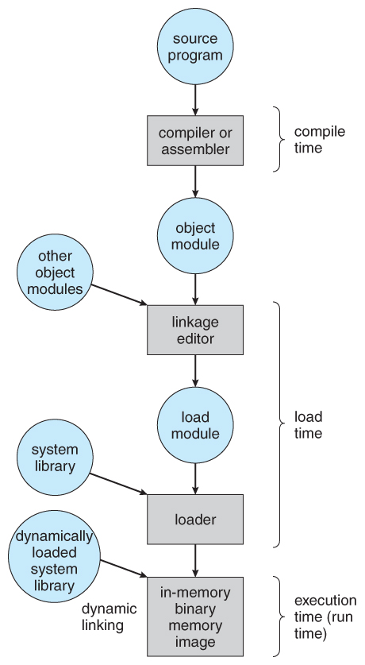
Memory Management
Address Binding
Compile Time Address Binding (min time, collision if the certain memory address is occupied by another program).
Load Time Address Binding (load addresses, (0, 4000) to (2000, 6000))
Execution Time Address Binding (runtime relocating the addresses, e.g., Young lady in flight).
Dynamic Loading
Only main function will be loaded first.
Others will be loaded when asked for.

Slide 4
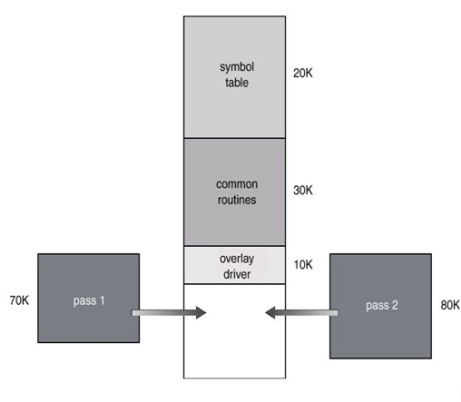
Memory Management
Dynamic Linking
Libraries will not get loaded into the memory until the modules are executing a certain function.
For example, two separate functions for both if and else conditions.
Overlays
It keeps only those part of program or instructions in the memory which is needed at any given time.

Slide 5
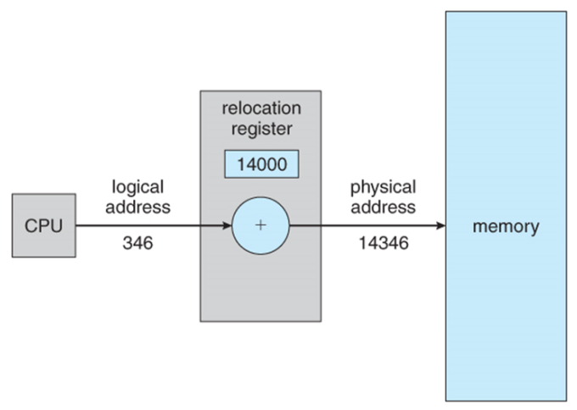
Logical vs. Physical Address Space

Slide 6
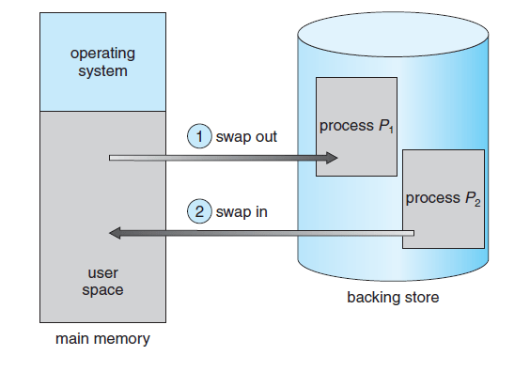
Swapping

Slide 7
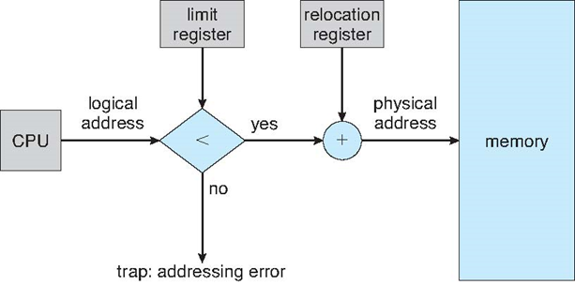
Memory Allocation Schemes
Single partition allocation
Multi partition allocation

Slide 8
Single Partition Memory Allocation
Processes | Memory (KB) | Exec. Time | Rem. Time (4) | Rem. Time (9)
P1 | 600 | 9 | 5 | 0
P2 | 1000 | 4 | 0 | 0
P3 | 300 | 19 | 15 | 10
P4 | 700 | 7 | 7 | 2
P5 | 550 | 14 | 14 | 14
Memory Space
0 KB
OS
2170 KB Free Space
450 KB
2620 KB
0 Time Unit
4 Time Unit
9 Time Unit
0 KB
0 KB
OS
P5
50 KB Free Space
P4
300 KB Free Space
P3
270 KB Free Space
0 KB
OS
P1
P2
P3
270 KB Free Space
OS
P1
P4
300 KB Free Space
P3
270 KB Free Space
450 KB
450 KB
450 KB
1000 KB
1050 KB
1050 KB
1750 KB
1050 KB
2050 KB
1750 KB
2050 KB
2350 KB
2350 KB
2050 KB
2350 KB
2620 KB
2620 KB
2620 KB

Slide 9

Multi Partition Memory Allocation Strategies
First Fit
Best Fit
Worst Fit

Slide 10
First Fit
Processes | Memory Required
P1 | 220 KB
P2 | 420 KB
P3 | 120 KB
P4 | 430 KB
 | Memory Space
Processes | 150 KB | 550 KB | 250 KB | 350 KB | 650 KB
P1 (220 KB) |  | 330 KB
P2 (420 KB) |  |  |  |  | 230 KB
P3 (120 KB) | 30 KB
P4 (430 KB) | Process having memory size of “430 KB” can not be allocated to memory space.
(In Order)

Slide 11
Best Fit
Processes | Memory Required
P1 | 220 KB
P2 | 420 KB
P3 | 120 KB
P4 | 430 KB
 | Memory Space
Processes | 150 KB | 550 KB | 250 KB | 350 KB | 650 KB
P1 (220 KB) |  |  | 30 KB
P2 (420 KB) |  | 130 KB
P3 (120 KB) |  | 10 KB
P4 (430 KB) |  |  |  |  | 220 KB
(In Order)

Slide 12
Worst Fit
Processes | Memory Required
P1 | 220 KB
P2 | 420 KB
P3 | 120 KB
P4 | 430 KB
 | Memory Space
Processes | 150 KB | 550 KB | 250 KB | 350 KB | 650 KB
P1 (220 KB) |  |  |  |  | 430 KB
P2 (420 KB) |  | 130 KB
P3 (120 KB) |  |  |  |  | 310 KB
P4 (430 KB) | Process having 430 KB can’t be allocated
(In Order)

Slide 13
Exercise
Consider six memory partitions of size 200KB, 400KB, 600KB, 500KB, 300KB, 250KB. These partitions need to be allocated to 4 processes of sizes 357KB, 210KB, 468KB, and 498KB in order. Apply the memory allocation strategies (i.e., First Fit, Best Fit, Worst Fit).

Slide 14
Compaction and Coalescing
Coalescing is the process in which two adjacent memory spaces are merged into a single larger space.
Compaction is the process in which all the free memory spaces are combined into one big space by moving the processes downward or upward as far as possible.

Slide 15
Compaction and Coalescing Example
First Possibility
Second Possibility
Third Possibility
0 KB
0 KB
0 KB
0 KB
OS
P1
P2
400 KB Free
P3 (200 KB)
300 KB Free
P4 (400 KB)
200 KB Free
OS
P1
P2
P3
P4
900 KB Free
OS
P1
P2
P4
P3
900 KB Free
OS
P1
P2
900 KB Free
P4
P3
400 KB
400 KB
400 KB
400 KB
600 KB
600 KB
600 KB
600 KB
700 KB
700 KB
700 KB
700 KB
1100 KB
1100 KB
900 KB
1300 KB
1300 KB
1300 KB
1600 KB
1600 KB
2000 KB
2000 KB
2200 KB
2200 KB
2200 KB
2200 KB
2 moves required and 600 KB data moved (P3 & P4 moved up)
1 move required and 400 KB data moved (P4 moved up)
1 move required and 200 KB data moved (P3 moved down)

Slide 16
Coalescing Example
0 KB
0 KB
OS
P1
400 KB Free
200 KB Free
P2
OS
P1
600 KB Free
P2
450 KB
450 KB
900 KB
900 KB
1300 KB
1500 KB
1500 KB
2100 KB
2100 KB

Slide 17
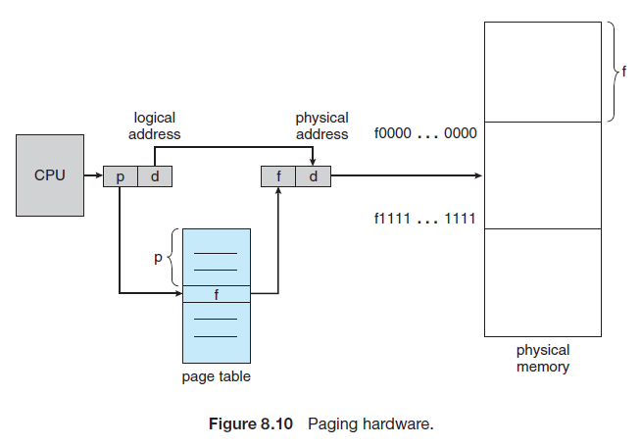
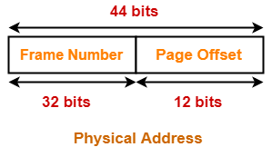
Memory Management using Paging

Slide 18
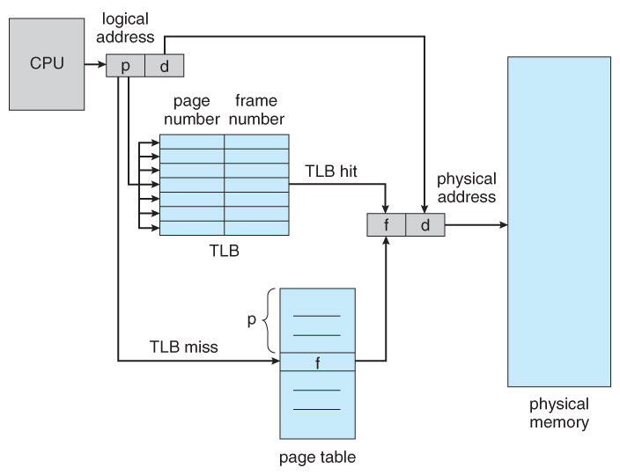
Memory Management using Paging

Slide 19
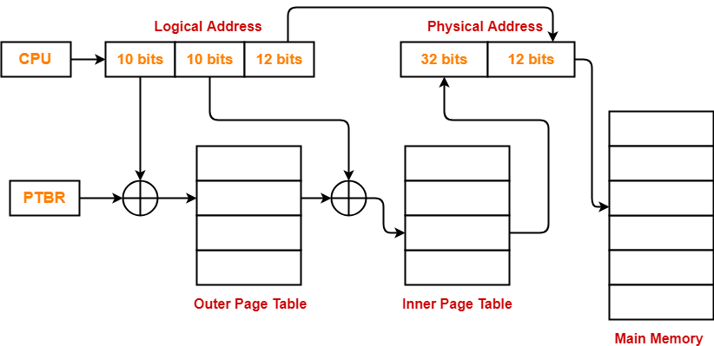
Multi-level Paging

Slide 20
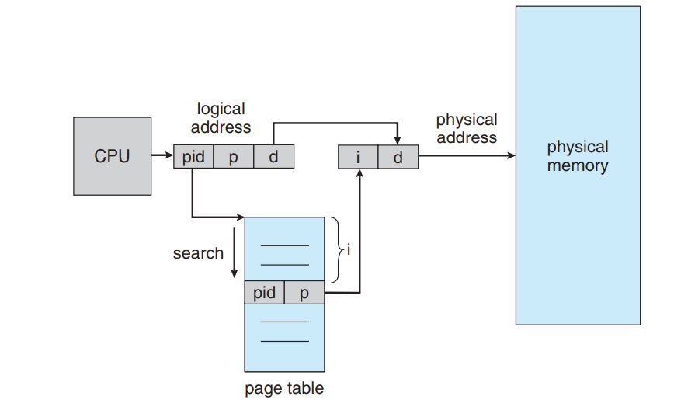
Multi-level Paging [Inverted Table]

Slide 21

Segmentation
Disadvantage of paging
It requires equal-size partitioning of pages
What if a process P1 requires 4090KB of memory space?
What if a process P2 requires 300KB of memory space?
Segmentation
It does not require equal-size of pages.
It maintains the page size as required for a certain process.

Slide 22
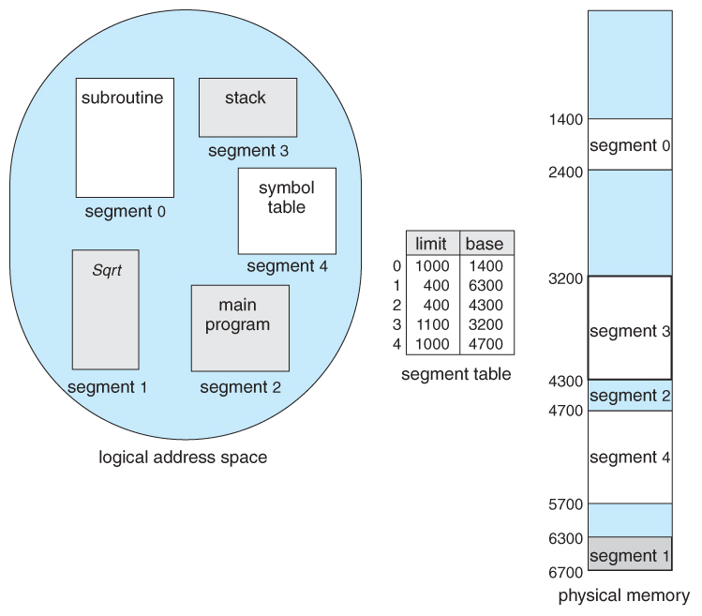
Segmentation

Slide 23
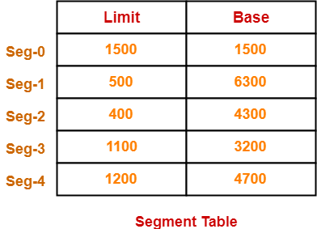
Exercise

Slide 24
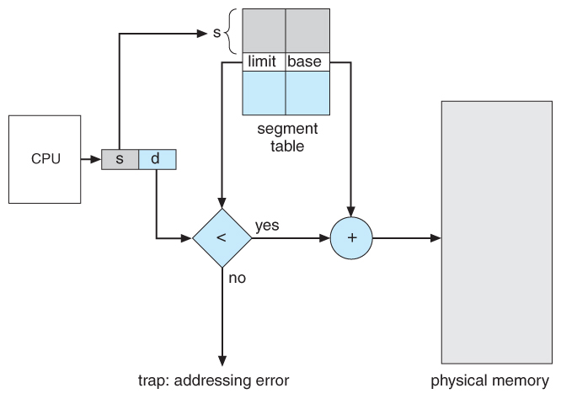
Hardware for Segmentation

Slide 25
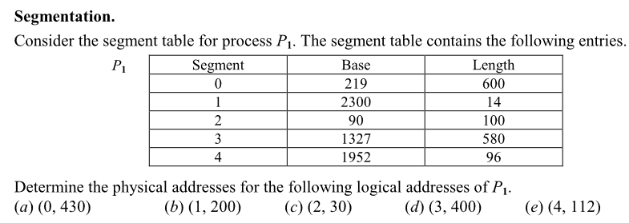
Exercise

Slide 26

References
https://youtu.be/k8XJK_Fm6WQ
https://youtu.be/EHB-HscXypM
https://youtu.be/TirLtkGjs-k
https://youtu.be/sIHjxnid38E
https://youtu.be/ortysvMPQ0Y
https://youtu.be/bMgDPc3tdL8
https://youtu.be/SjNsBGqtLGg
https://youtu.be/AtxvPmoin7s
https://youtu.be/LrTM93f3DO4
https://youtu.be/s8tNF-JaYBI

Slide 27
Thank You(Q & A)

